Slide 1
JCM OSCE Questions
PMH A&E
Dr. Tse Choi Fung
Dr. Lung Ka Yan Ashley
Dr. Chan Chi Ming
(4/1/2017)

Slide 2
Case 1
An 80-year-old man presented with syncope in the restaurant. This is the ECG:

Slide 3
Case 1
What are the ECG abnormalities? (3 marks)
What is the diagnosis? (1 mark)
What is the definite treatment? (1 mark)

Slide 4
Case 2
A 70-year-old man presented with back pain for 6 months. This is the x-ray:

Slide 7
Case 2
What are the x-ray findings? (4 marks)
What is the provisional diagnosis? (1 mark)
What are the common causes for the diagnosis? (3 marks out of 5)
What other symptoms may this patient present? (2 marks out of 3)
What are the complications that this patient may suffer from? (2 marks)

Slide 8
Case 3
A 50-year-old man presented with confusion. H’stix was 2.0 mmol/L. He did not have history of diabetes mellitus.
What is the likely diagnosis & how can you confirm your diagnosis? (4 marks)
What laboratory investigations would you like to do to find out the underlying causes? (4 marks out of 7)

Slide 9
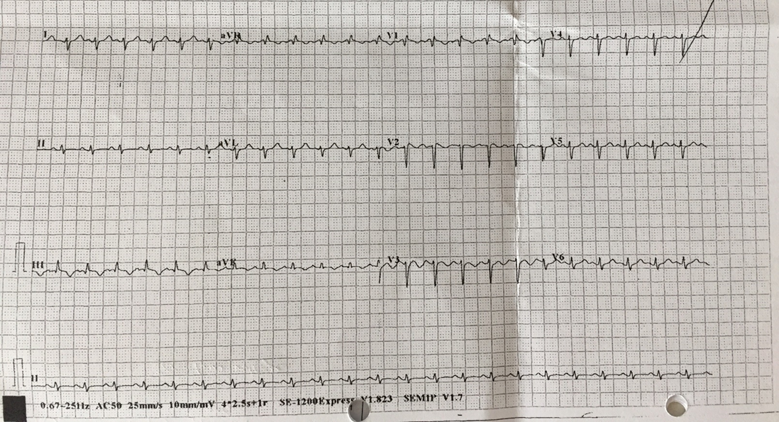
Case 4
A 35-year-old lady presented with fever for 2 weeks with epigastric pain.
T 40.1 ⁰C BP 128/99 P 138/min
ECG was performed in triage because of tachycardia.

Slide 10
Case 4
What are the ECG abnormalities? (5 marks)

Slide 13
Case 4
What are the x-ray findings? (3 marks out of 4)
What is the provisional diagnosis? (1 mark)
What are the possible causes of her diagnosis? (2 marks out of 3)

Slide 14
Case 5
A 42-year-old man sustained crush injury over left middle finger at work.
A 2.5 cm long laceration was seen over dorsum of left middle finger near DIPJ.
X-ray was performed.

Slide 15
Case 5

Slide 16
Case 5
What are the x-ray findings? (3 marks)
What is the diagnosis? (1 mark)
What is the underlying pathology of his condition? (2 marks)

